Slide 1
Communication & presentation skills SS-152
WEEK 7

Slide 2

Week 7 LISTENING SKILLS

Slide 3
Areas to be covered:
Definitions
Difference between hearing and listening.
Objectives and importance of listening.
Listening process.
Strategies for improving listening skills.
Types of listening.

Slide 4
What is Listening Comprehension?
1. Active process of receiving and responding to spoken messages.
2. It is the ability to accurately receive and interpret messages in the communication process
3. Act of understanding an oral message. It is an extremely complex activity (Buck, 2001) that requires much more than simple perception of the acoustic signal (absorbing sound) .

Slide 5
What is Listening Comprehension?
4. It involves speech decoding and comprehending.
5. Listening comprehension is not something that happens because of what the speaker says, but “the listener has a crucial part to play in the process, by activating various types of knowledge and by applying what he knows to what he hears and trying to understand what the speaker means” (Anderson & Lynch, 1988: 6).

Slide 6
Hearing vs listening

Slide 7
Hearing vs Listening
Hearing is simply the act of perceiving sound by the ear. Ends at ‘receiving.’
Hearing occurs with or without our consent
Listening is an action where we actively concentrate on what we hear
In listening our brain processes the information into knowledge

Slide 8
Listening comes first
The first and the foremost communication skill that we learn in our lives is nothing but ‘LISTENING’
LISTENING
SPEAKING
READING
WRITING

Slide 9
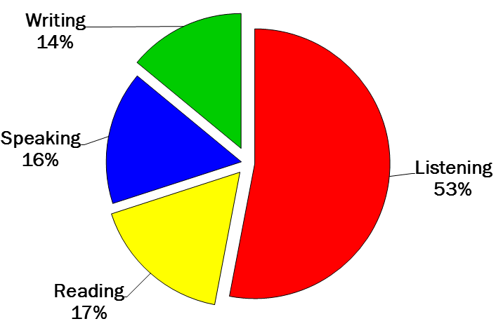

Slide 10
Importance of Listening Skills

Slide 11
Communication is not complete without effective listening
An attentive listener stimulates better speaking
A good listener learns more than an indifferent listener
A good listener can restructure vague speaking in a way that produces clearer meaning
A good listener learns to detect prejudices, assumptions and attitudes

Slide 12
What Is Listening?
Listening can be described as a series of five steps: receiving, understanding, remembering, evaluating, and responding.

Slide 13
1. Receiving
Receiving messages is a highly selective process. Listener selectively tune in to the valuable and interesting sounds only.
Verbal and non-verbal cues are recognized.
To improve your receiving skills:
Look at the speaker; make your mind follow your body.
Focus your attention on the verbal and nonverbal messages.
Avoid attending to distractions in the environment.
Focus on speaker`s words rather than on any questions or objections you may have.

Slide 14
2. Understanding
It includes both the thoughts that are expressed as well as the emotional tone that accompanies these thoughts, for example, the urgency or the joy or sorrow expressed in the message.
To enhance understanding:
Relate the new information to what you already know.
See the speaker’s messages from the speaker’s point of view; avoid judging the message until you fully understand it as the speaker intended it.
Rephrase the speaker’s ideas into your own words while listening.

Slide 15
3. Remembering
Messages received and understood should be retained.
What you remember is “your understanding of the message.”
Memory for speech isn’t reproductive; you don’t simply reproduce the received message in your memory. Rather, memory is reconstructive; you actually reconstruct the messages you hear into a system that seems to make sense to you.
In remembering:
Identify the thesis or central idea and the major propositions.
Summarize the message: don`t ignore crucial détails or important qualifications.
Repeat names and key concepts to yourself.
Identify the organizational pattern and use it (visualize it).

Slide 16
4. Evaluating
Evaluating consists of judging the message and the speaker’s credibility, truthfulness, or usefulness.
Here your biases and prejudices may influence what you judge good and bad.
When evaluating:
Resist evaluation until you understand the speaker’s point of view.
Distinguish facts from inferences, opinions, and personal Interpretations.
Identify any biases, self-interests, or prejudices that may hinder meaning making and lets you forget the opposing ideas.

Slide 17
5. Responding/Feedback
Responding occurs in two phases:
(1) nonverbal (occasionally verbal) responses you make/give while the speaker is talking. Include gestures such as nodding your head, smiling, and leaning forward.
(2) responses you make after the speaker has stopped talking.
They include questions of clarification (“I wasn’t sure what you meant by…), expressions of agreement (“You’re absolutely right”), and expressions of disagreement (“I disagree that…”).

Slide 18
4 Major Causes Of Poor Listening
Not Concentrating (pg. 96)
Listening Too Hard (pg. 97)
Jumping to Conclusion (pg.98)
Focusing on Delivery & Personal Appearance (pg.99)

Slide 19
How to become a better listener
STRATEGIES FOR IMPROVING LISTENING SKILLS

Slide 20
The Three Stages Of A Listening
1. Pre-listening :preparation stage.
Connect prior knowledge with the topic, use guesses to predict.
2. While -listening stage: actual listening & task response.
Listen for major and minor details you need for answers,
Preview the questions before listening, circle the information and listen carefully- analyse the task. Take notes- Comments, outlines, charts, maps, use abbreviations, symbols, intonations etc. re-listen- summarize, use synonyms.
3. Post-listening stage: feedback & remedial work.
Opinionated response, agree, disagree, use symbols-punctuations, summarize, extend listening.

Slide 21
Strategies to be used in order to become a better speaker

Slide 22
Bottom-up processes
Listeners should retain and recognize:
Input while it is being processed.
Word divisions and key/content words in utterances.
Key transitions in a discourse.
Grammatical relations between key elements in sentences.
The function and purpose of word stress and intonation in sentences.

Slide 23
Top-down Processes
While listening, listeners should:
Use key words to identify genre and purpose of the utterance.
Infer the role of the participants, topic, the outcome, the cause and effect of an event.
Infer unstated details, sequence of events and comparisons.
Distinguish between facts and opinions.

Slide 24
In a nutshell.
Take Listening Seriously
Be an Active Listener
Resist Distractions
Don’t be Diverted by Appearance or Delivery
Suspend Judgment- Biases & prejudices
Focus Your Listening
Develop Note-Taking Skills

Slide 25
Types of listening

Slide 26

Types of Listening that people use commonly in Communication

Slide 27
1. Participatory/Active Listening:
Active listening is a skill that can be acquired and developed with practice.
Active listening not only means focusing fully on the speaker but also actively showing verbal and non-verbal signs of listening.
It involves physical alertness. Assuming an upright posture. The speaker is focused. Participating in communication interaction as an equal partner with the speaker. Being emotionally and intellectually ready to engage in the active sharing of the meaning.
(e.g.: discussions, debates, group activities, etc.)

Slide 28
Signs of Active Listening
Non-Verbal Signs of Attentive or Active Listening
Smile
Eye Contact
Posture
Distraction

Slide 29
Verbal Signs of Attentive or Active Listening
Positive Reinforcement
Remembering
Questioning
Reflection
Clarification

Slide 30
CRITICAL/JUDGEMENTAL LISTENING
“It is listening to evaluate a message for purposes of accepting or rejecting it.”
Aim of the listener is to judge whether the speaker is credible, logical, right or wrong, fair or unfair and whether they are being duped or manipulated by the speaker. A position is made known once judging.

Slide 31
Factors affecting listening comprehension
Language and Speech: Different people speak with different meanings due to different experiences beliefs, accents, linguistic, non linguistic and paralinguistic (tone of voice) knowledge.
Nonverbal Differences Speakers from different cultures have different nonverbal behaviors which are appropriate and inappropriate for a public setting.

Slide 32
Factors affecting listening comprehension
Ethnocentrism: The tendency to evaluate the values, beliefs, and behaviors of your own culture as being more positive, logical, and natural than those of others.
The non-ethnocentric would see both himself or herself and others as different but equal, with neither being inferior nor superior.
Gender and Listening:
“women seek to build rapport and establish a closer relationship. Men play up their expertise, emphasize it, and use it to dominate the interaction.”
Deborah Tannen

Slide 33
Thanks for listening ☺

